Slide 1

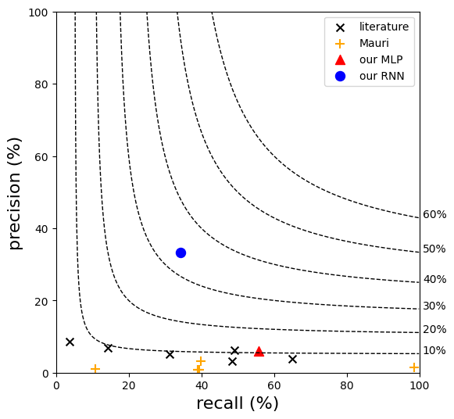

Performance comparison
lines are different values of F1 score = $2\frac{PR}{P+R}$
Past O-GlcNAcylation models have an F1 score of ~10% or lower, including
YinOYang
OGP
Random forest (RF)
Support vector machine (SVM)
Multi-layer perceptron (MLP)
Our RNN model achieves an F1 score of ~33%
1

Slide 2
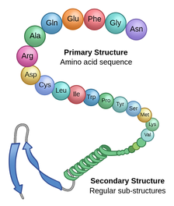


Glycosylation site prediction
To predict whether the target site would be O-glycosylated
O-Glycosylation
Target site
[S/T]
$Positive$
Data-driven
model
0.65
Calculate
probability
$Negative$
This figure is from [1]
0.35
[1] Labster Theory pages, Protein Structure, https://theory.labster.com/protein-structure/

Slide 3
Previous studies
Losing sequential information of amino acid sequence
Subsite # | -4 | -3 | -2 | -1 | 0 | 1 | 2 | 3 | 4
Residue | I | W | P | Y | S | M | K | V | A
Flexibility | 0.72 | 0.71 | 0.71 | 0.70 | 0.70 | 0.69 | 0.67 | 0.66 | 0.65
SASA | 9 | 19 | 24 | 23 | 27 | 40 | 52 | 41 | 40
Target site
[S/T]
Sequence window
1D
Feature vector
I | 0.72 | 9 | W | 0.71 | 19 | … | S | 0.70 | 27 | … | A | 0.65 | 40
No sequential information
Random
Forest
Support
Vector
Machine
Multi-layer
Perceptron
ML models
used in past studies
Best performance
F1 score: 11.01 %
Mauri (2021), Advances and Applications in Bioinformatics and Chemistry, O-GlcNAcylation Prediction: An Unattained Objective

Slide 4







Recurrent neural networks (RNNs)
To capture the sequential information from amino acid sequence
Target site
[S/T]
Subsite # | -4 | -3 | -2 | -1 | 0 | 1 | 2 | 3 | 4
Residue | I | W | P | Y | S | M | K | V | A
Sequence window
$$x_{1}$$
$$x_{2}$$
$$x_{2}$$
$$x_{target}$$
$$x_{2}$$
$$x_{T}$$
RNN
RNN
RNN
RNN
RNN
RNN
$$…$$
$$…$$
Recurrent unit captures sequential dependencies among amino acids
DNN
64%
Probability of
O-glycosylation

Slide 5
Outline
Group activity for glycosylation project
Machine learning for glycosylation site prediction
Hybrid modeling: mechanistic + machine learning
Mechanistic model to augment features
Feature selection for model optimization

Slide 6
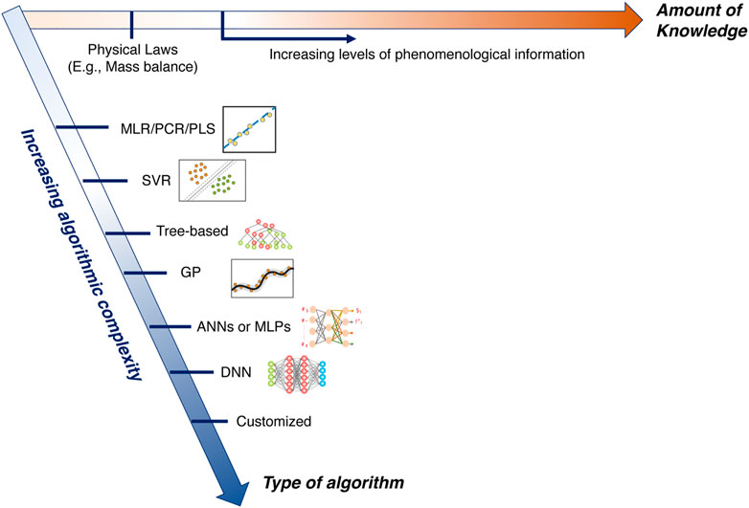
What is hybrid model?
Combination of mechanistic and data-driven model
Mechanistic model
Data-driven model
Based on domain knowledge
Requires mathematical expressions to describe the underlying physical/biological system
Can be computationally expensive
Transferrable across different process conditions
Usually less computationally expensive
Capability of modeling systems in which the mechanisms are not well understood
Requires large amount of data to make accurate and reliable predictions
The choice depends on the availability of data and degree of mechanistic knowledge
Narayanan (2023), Frontiers in Chemical Engineering, Hybrid modeling for biopharmaceutical processes: advantages, opportunities, and implementation

Slide 7
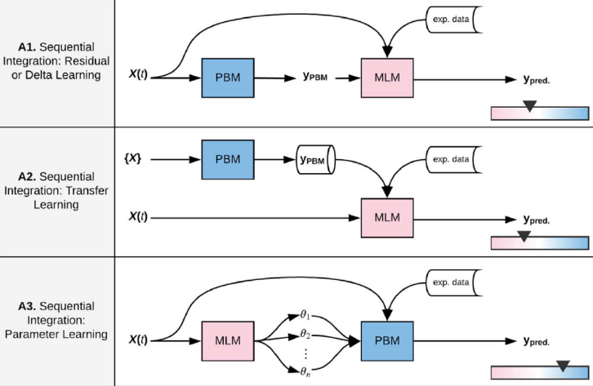
Various types of hybrid model
Sequential integration of mechanistic and data-driven model
Baseline physics can be captured by PBM, while the MLM learns the delta
Using PBM to generate supplemental
knowledge to help train the MLM on exp. data
MLM predicts parameters of PBM,
PBM uses the parameters for prediction
Aykol (2021), Journal of The Electrochemical Society, Perspective—Combining Physics and Machine Learning to Predict Battery Lifetime
Narayanan (2023), Frontiers in Chemical Engineering, Hybrid modeling for biopharmaceutical processes: advantages, opportunities, and implementation

Slide 8
Outline
Group activity for glycosylation project
Machine learning for glycosylation site prediction
Hybrid modeling: mechanistic + machine learning
Mechanistic model to augment features
Feature selection for model optimization

Slide 9
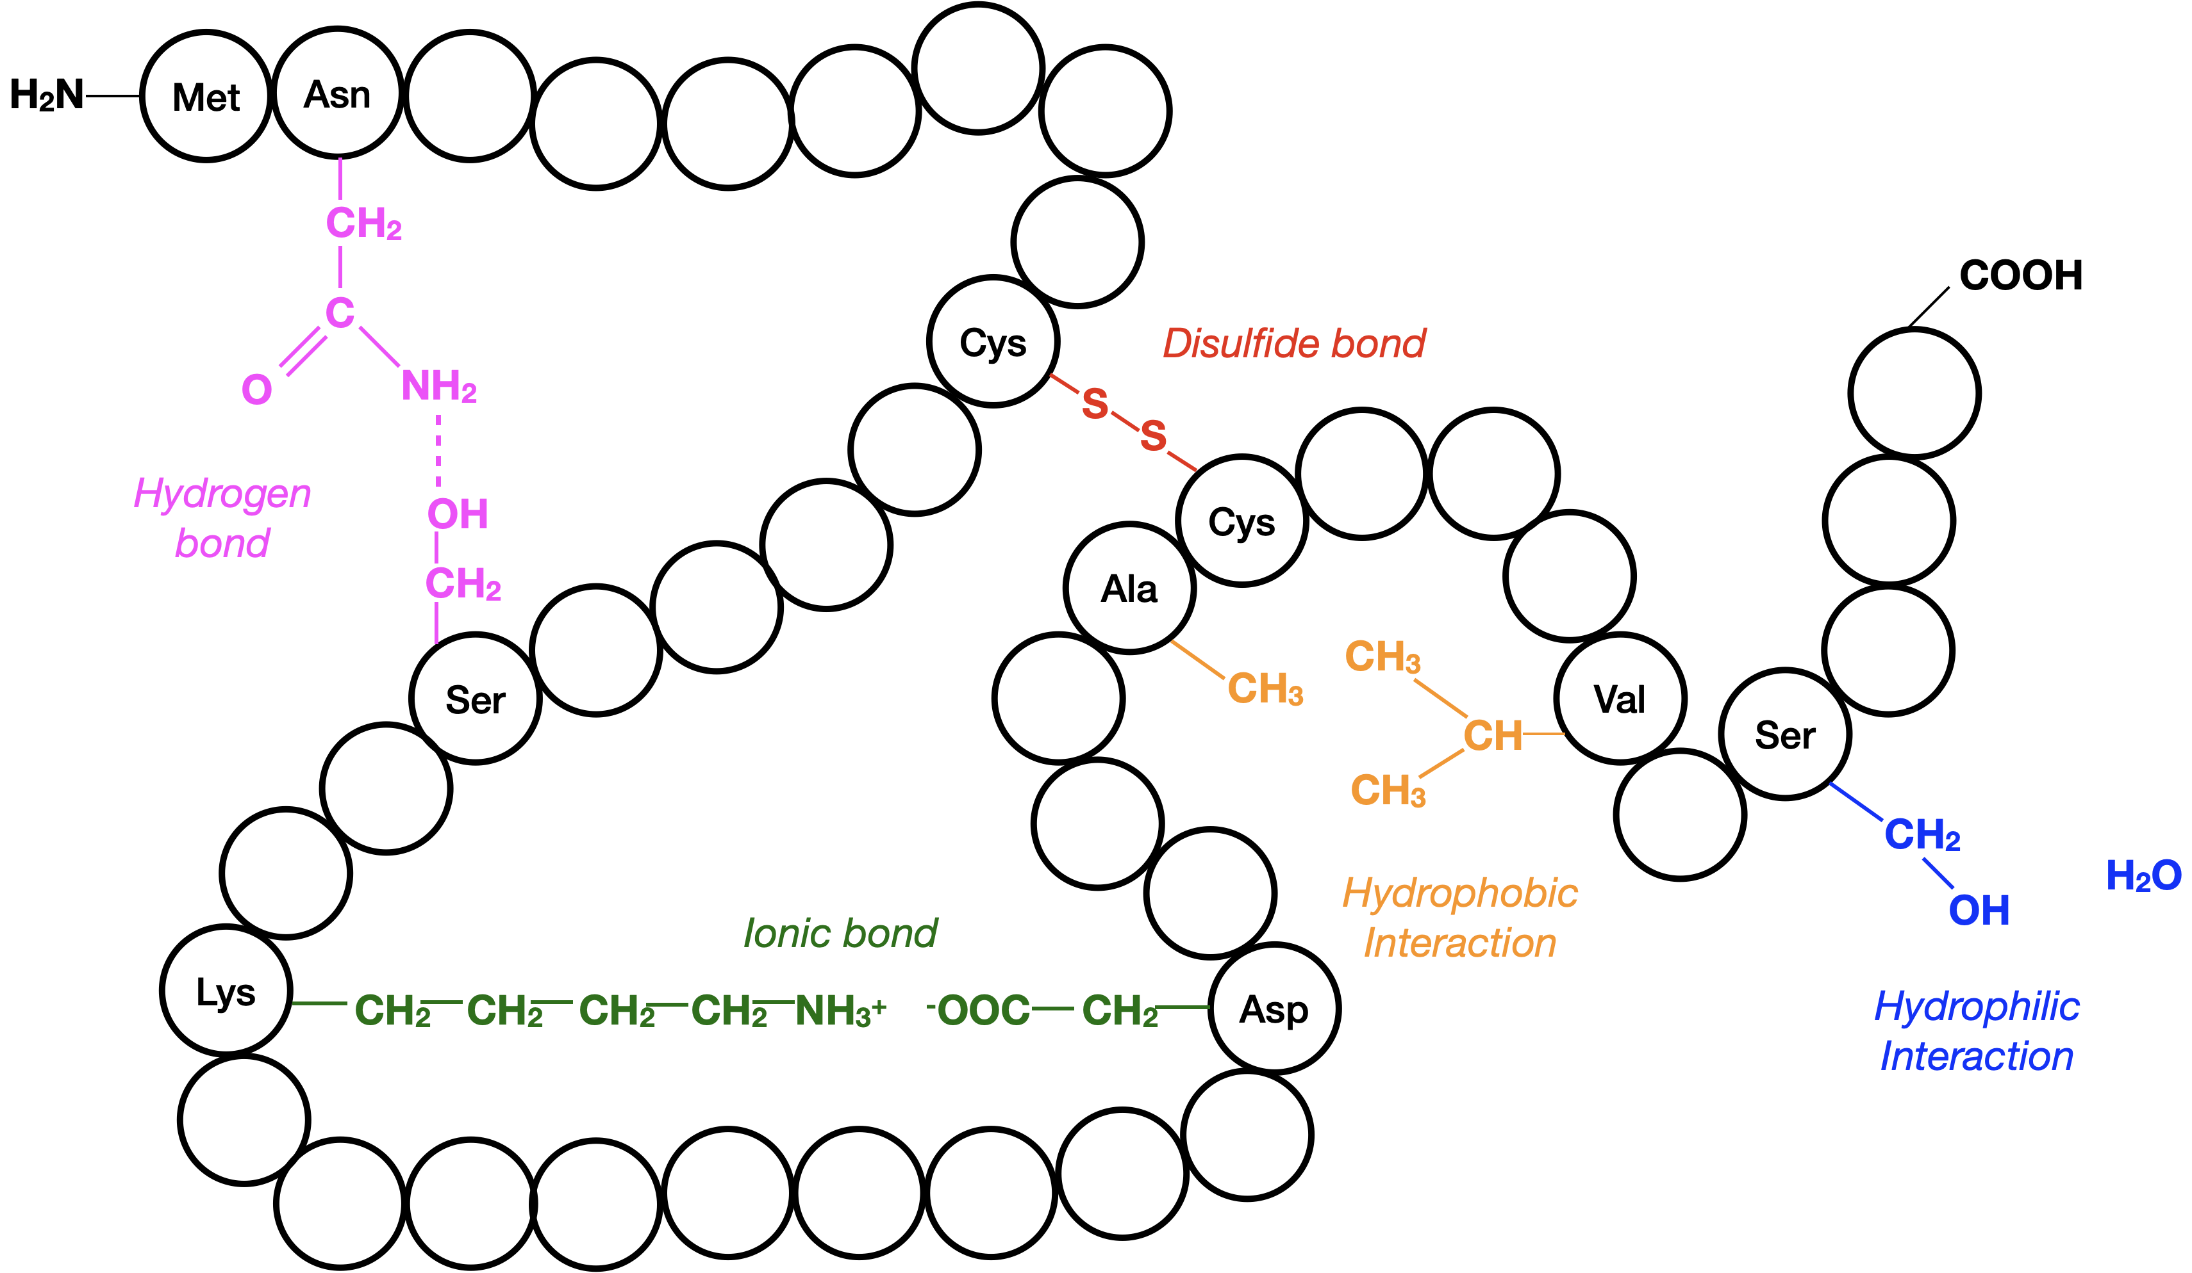
Limitation of sequence window
Tertiary structure due to chemical interactions
Neighbors might influence the target site
Target site
[S/T]
This figure is from [1]
Sequence window
Subsite # | -4 | -3 | -2 | -1 | 0 | 1 | 2 | 3 | 4
Residue | I | W | P | Y | S | M | K | V | A
Flexibility | 0.72 | 0.71 | 0.71 | 0.70 | 0.70 | 0.69 | 0.67 | 0.66 | 0.65
SASA | 9 | 19 | 24 | 23 | 27 | 40 | 52 | 41 | 40
[1] Melissa Hardy, Tertiary structure, https://slcc.pressbooks.pub/collegebiology1/chapter/7-3-protein-structure/

Slide 10
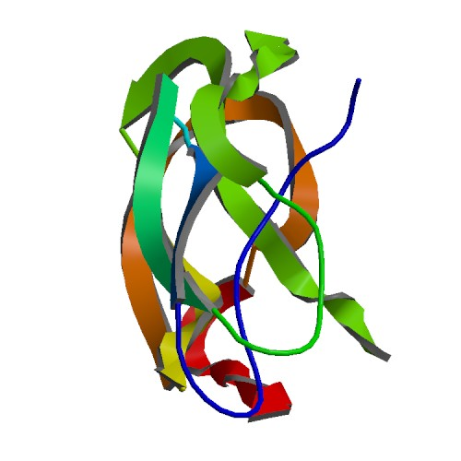
Hybrid method for improving model
Feature augmentation from the protein structure
Count the number and calculate the solvent accessibility of residues
Hydrophobicity
Hydrophobic / hydrophilic
Raw data -> feature
Further ways of integrating information
Physics-based
model
Polarity
Polar / non-polar / aromatic / aliphatic
5 Å
Charge
Positively / negatively / uncharged
Feature window around a target site
Volume
Very small / small / normal / long / proline
Sumit (2019), iScience, Dissecting N-Glycosylation Dynamics in Chinese Hamster Ovary Cells Fed-batch Cultures using Time Course Omics Analyses

Slide 11
Hybrid method for improving model
Feature augmentation from the protein structure
Raw data -> feature
Further ways of integrating information
5 Å
0 Å
25 Å
Feature windows around a target site (0 to 25Å)
Sumit (2019), iScience, Dissecting N-Glycosylation Dynamics in Chinese Hamster Ovary Cells Fed-batch Cultures using Time Course Omics Analyses

Slide 12
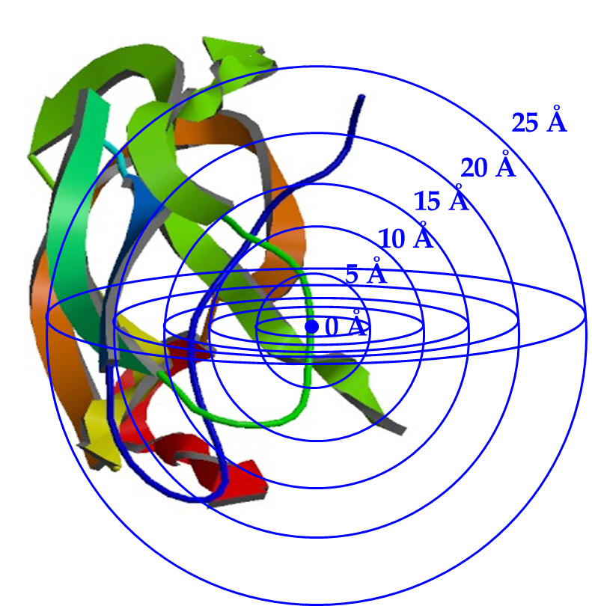
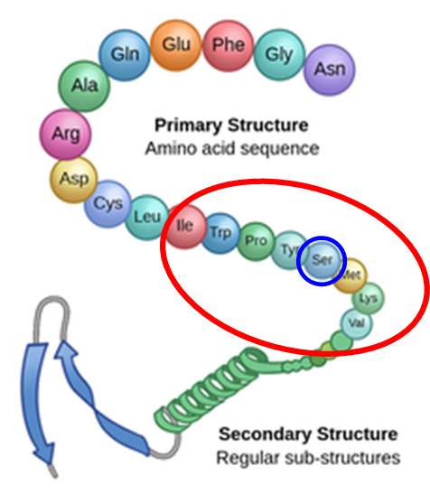
Model comparison
Prediction accuracies (F1 score) by different variable sets
534
Augmented
features
+
20
Amino acids
sequence
20
Amino acids
sequence
Model A
(with 20 features)
Model B (with 554 features)
Sumit (2019), iScience, Dissecting N-Glycosylation Dynamics in Chinese Hamster Ovary Cells Fed-batch Cultures using Time Course Omics Analyses

Slide 13


Limitation of black-box model
Results are harder to interpret
Input features | Input features
Amino acid sequence | Feature 1
 | Feature 2
 | ..
 | Feature 19
 | Feature 20
Augmented features | Feature 21
 | Feature 22
 | …
 | Feature 553
 | Feature 554
O-Glycosylation
$Positive$
Black Box
Input → output
0.65
$Negative$
Input
Output
0.35
Which feature improved the model?
Sumit (2019), iScience, Dissecting N-Glycosylation Dynamics in Chinese Hamster Ovary Cells Fed-batch Cultures using Time Course Omics Analyses

Slide 14
Outline
Group activity for glycosylation project
Machine learning for glycosylation site prediction
Hybrid modeling: mechanistic + machine learning
Mechanistic model to augment features
Feature selection for model optimization

Slide 15
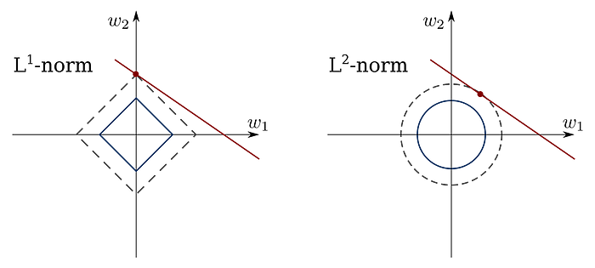
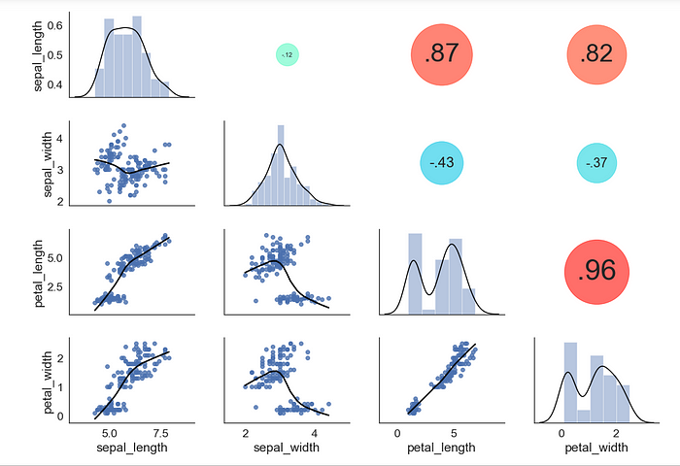
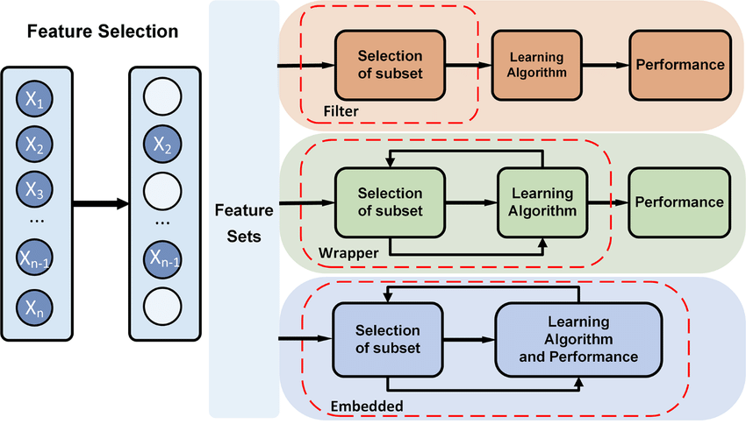
Feature selection for model optimization
Various methods of feature selection
Finding and using the most relevant features is the goal of feature selection algorithms
Feature selection
Filter
Wrapper
Embedded
Forward
selection
Backward
elimination
1
2
3
4
5
6
1
2
3
4
5
6
Add
Remove
Feature
set
Java T point, Feature Selection Techniques in Machine Learning, https://www.javatpoint.com/feature-selection-techniques-in-machine-learning
Ane (2023), Feature Selection 101: Beginners Guide
Xie (2020), Sensors, Computational Diagnostic Techniques for Electrocardiogram Signal Analysis

Slide 16
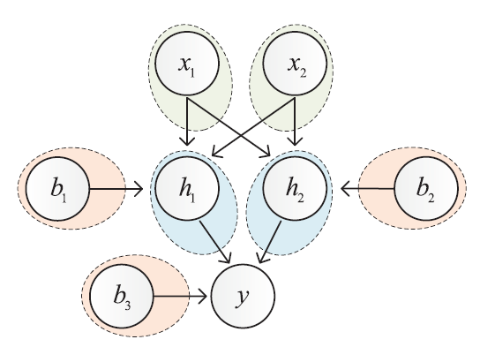
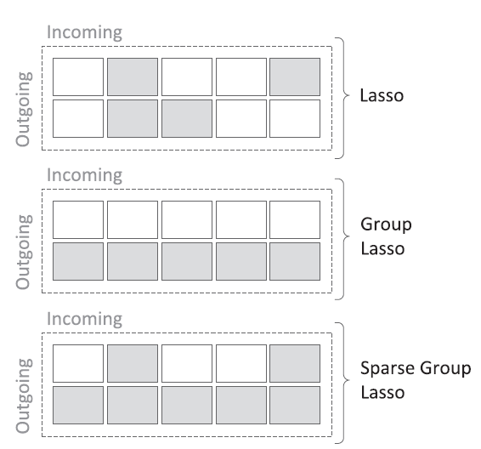
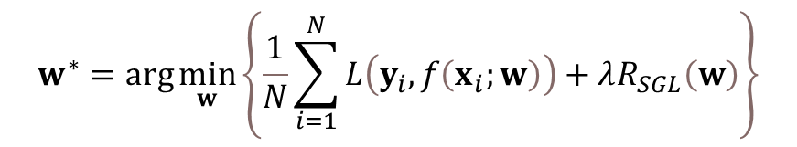

Sparse neural networks
Nonlinear neural networks + weight regularization (LASSO + group LASSO)
Incoming
Incoming
Outgoing Outgoing Outgoing
$$w^{∗}=\arg{\min_{w}\left\{\frac{1}{N}\sum_{i=1}^{N}{L\left(y_{i}, f\left(x_{i};w\right)\right)+λR_{SGL}\left(w\right)}\right\}}$$
Incoming
$$R_{SGL}\left(w\right)=\sum_{g∈𝒢}{\sqrt{\left|g\right|}{\left\|g\right\|}_{2}}+{\left\|w\right\|}_{1}$$
Scardapane (2016), Neurocomputing, Group Sparse Regularization for Deep Neural Networks

Slide 17
Sparse neural networks
Standard networks vs. sparse networks
Standard Neural Networks
Input
layer
Dense
layer
Sparse Neural Networks
Input
layer
Dense
layer
(i) the weights of a neural network (ii) the number of neurons for each hidden layer (iii) the subset of active input features (i.e., feature selection)
Sparse regularization can optimize:

Slide 18
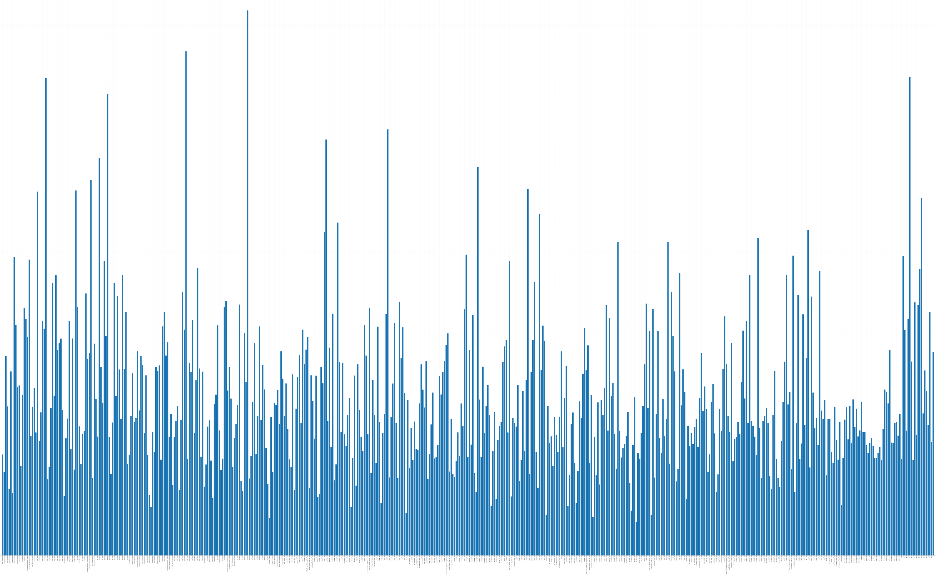
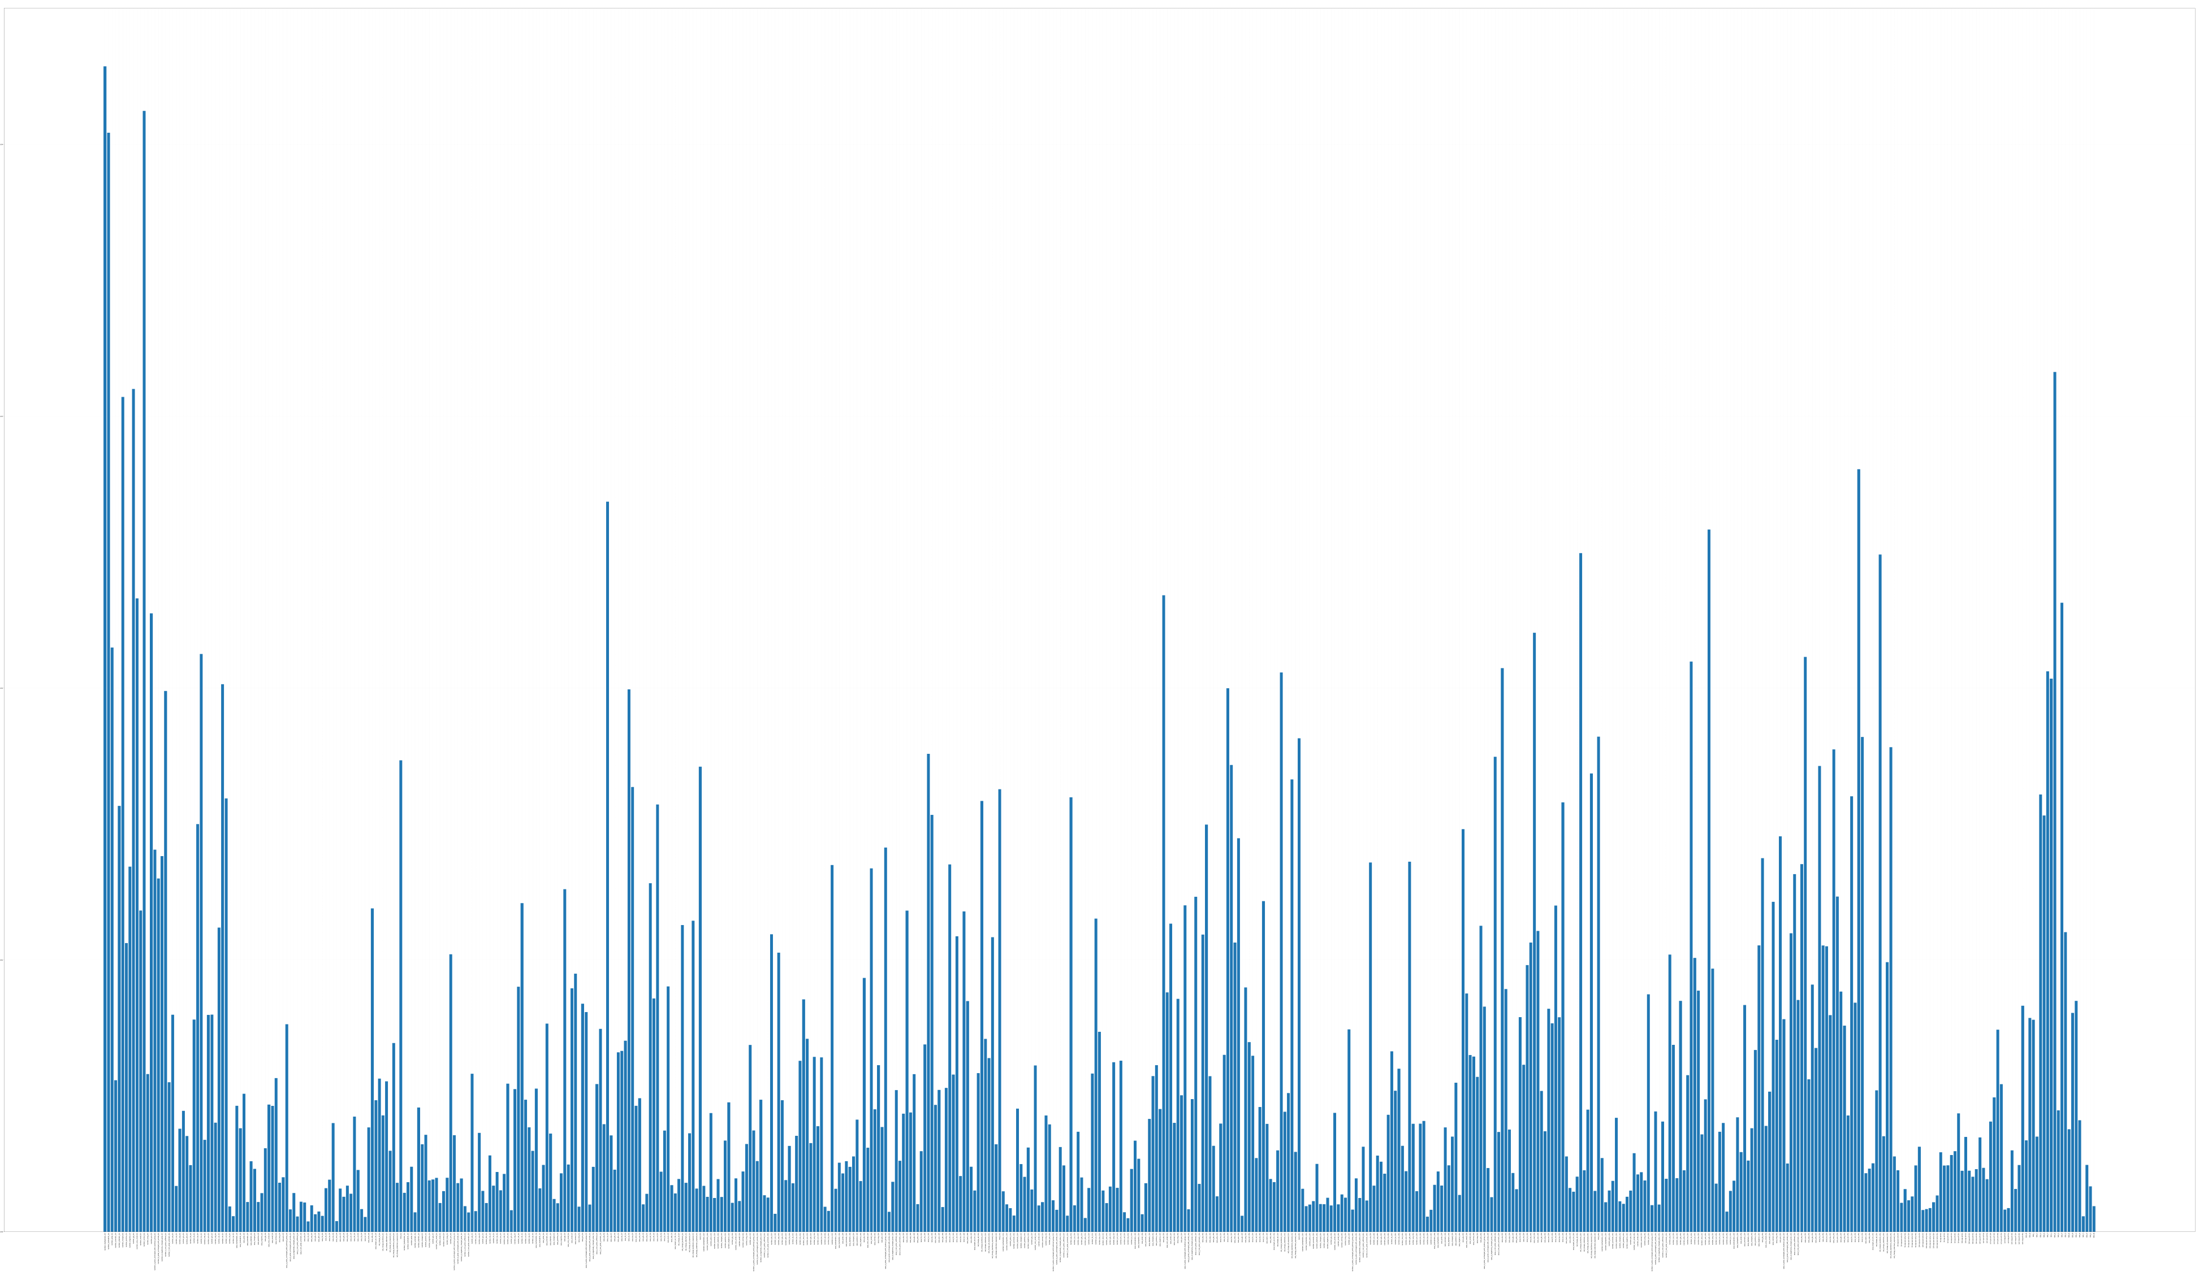
Select important features
Weight analysis from the trained sparse model
Standard Neural Networks
Sparse Neural Networks
554 features
554 features
How to choose important features?
Sumit (2019), iScience, Dissecting N-Glycosylation Dynamics in Chinese Hamster Ovary Cells Fed-batch Cultures using Time Course Omics Analyses

Slide 19
Find the best features
Adjusting the threshold of feature selection
> 50% of the maximum weight
90%
60%
50%
40%
30%
Re-train
model
Black Box
Input → output
Selected features
Sumit (2019), iScience, Dissecting N-Glycosylation Dynamics in Chinese Hamster Ovary Cells Fed-batch Cultures using Time Course Omics Analyses

Slide 20
Model comparison
Training time and classification performance
Sumit (2019), iScience, Dissecting N-Glycosylation Dynamics in Chinese Hamster Ovary Cells Fed-batch Cultures using Time Course Omics Analyses

Slide 21
Impact of important features
Selected vs. unselected features
534
Augmented
features
> threshold
≤ threshold
15
Selected
features
519
Unselected
features
+
+
20
Amino acids
sequence
20
Amino acids
sequence
Model A (with 35 features)
Model B
(with 539 features)
Sumit (2019), iScience, Dissecting N-Glycosylation Dynamics in Chinese Hamster Ovary Cells Fed-batch Cultures using Time Course Omics Analyses

Slide 22
Analysis of selected features
Sumit (2019), iScience, Dissecting N-Glycosylation Dynamics in Chinese Hamster Ovary Cells Fed-batch Cultures using Time Course Omics Analyses

Slide 23
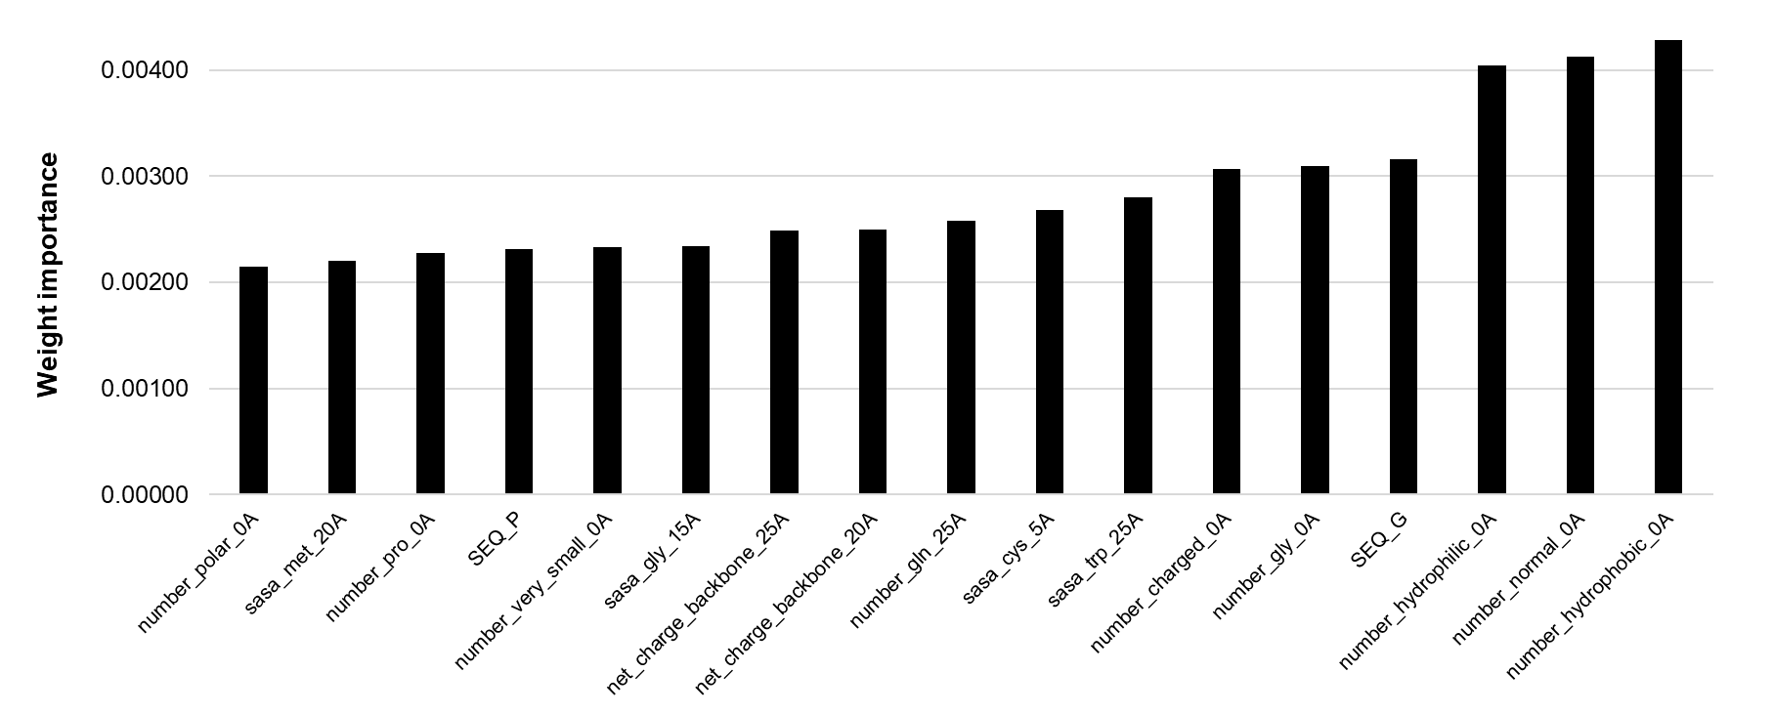
Summary
Protein sequence
Amino acid
sequence
Improve the model performance
Sparse
neural networks
Protein structure
+
Physics-based
model
Augmented
features
Weight
analysis
Find the best features for O-glycosylation prediction
Sumit (2019), iScience, Dissecting N-Glycosylation Dynamics in Chinese Hamster Ovary Cells Fed-batch Cultures using Time Course Omics Analyses

Slide 24
Thank you
skyhong@mit.edu

